Slide 1
LEVEL 9 MID-TERM PRESENTATION
Lucero Alhely Barraza Cedillo
4 “B” TDSM

Slide 2

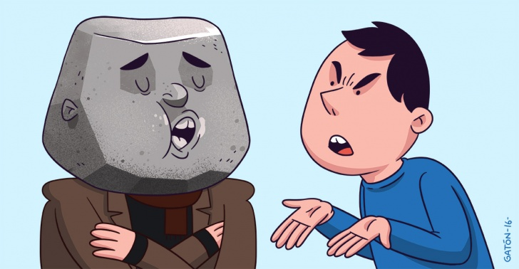
If I could change something…
Why am I going to do it,
if someone else can do it?

Slide 3


If I could change something else…

Slide 4


For your Attention

